Slide 1
PRME Working Group on Poverty as a Challenge to Management Education
GLOBAL POVERTY THE ROLE OF BUSINESSES AND BUSINESS SCHOOLS
13 May 2014

Slide 2
The world has 1 billion people suffering from Chronic poverty
There has been a 17.7 percent reduction in poverty from 2010. However poverty will fall only by 10% by 2030
While this is an improvement, extreme income inequality is a disincentive to Poverty Reduction
Jim Yong Kim, President of the World Bank

Slide 3
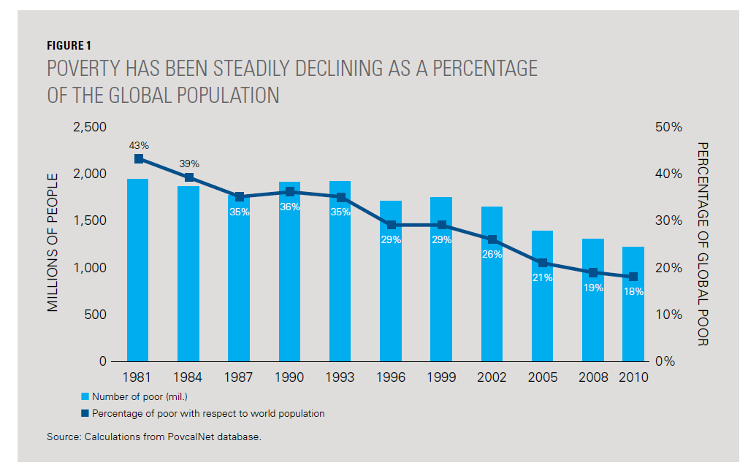
World Poverty Decline
Source: Poverty for All, World Bank 2014

Slide 4
To 9 % of world population by 2020
To 3% of World Population by 2030
Hard, but achievable
Targets for Poverty Reduction

Slide 5
Targets for Poverty Reduction
As people rise out of poverty and increase consumption (rightfully)…
As world population grows to 9 billion by 2050…
As the developed world continues to adopt growth and consumption driven business models…
As temperatures rise and the climate changes…
As critical resources (like water) are depleted…
Does the earth have the capacity to sustain us all?

Slide 6
Some key issues…
What is the role of business in society
What is the role of educational institutions and business schools in society?
What is the relationship between business schools, business and society?

Slide 7
Businesses & Business Schools for a Better World
UN Global Compact, 2000
Ten principles
Global Leaders Summits
Architects of a Better World: Building the Post-2015 Business Engagement Architecture (from MDGs to SDGs)
PRME, 2007
Six principles
Five annual assemblies (Global Forums and Summits)
PRME Working Groups
PRME Champion Group
PRME Regional chapters

Slide 8
Strategy Matrix – A tool
Strategies
Access to financial products and services
Market information
Regulatory environment
Physical infrastructure
Knowledge & skills
Adapt products and processes
Invest in removing constraints
Leverage the strengths of the poor
Combine resources and capabilities with others
Engage in policy dialogue with government
Constraints

Slide 9
Role of the Business School
CEEMAN survey on business schools‘ response to the Global Crisis (2009)
The crisis is not only financial; it is much deeper—economic and social. Above all, it is ethical and moral
Business schools were reluctant to assume their share of the responsibility

Slide 10
Role of the Business School…
Do Universities have a responsibility to society? And business schools?
What does it mean to be a responsible business owner/shareholder in todays world?
What does it mean to be a responsible manager in todays world?
What does responsible globalization mean?
3rd PRME Global Forum
Management Education for the Future We Want
The 2013 PRME Summit
New Ways of Developing Leaders for the Future We Want
The „4 I‘s of PRME“ – Inspiration, Innovation, Implementation, Impact

Slide 11
CEEMAN and CEEMAN/PRME surveys

Slide 12
Challenges
Understanding the language
Topic legitimacy
Prevailing mindsets and attitudes.
„Silo mentality”
Primacy of the quantitative disciplines
„Over packed” curriculum
Lack of qualified experts whose teaching would be based on
Relevant research
External incentives from the major international accreditation and ranking systems and schemes

Slide 13
Solutions
Close to home
Co-curricular activities
Action/service learning projects
Newly created course, minors and certificates
Graduation requirements
Strategies for legitimizing the topic
Participation in PRME

Slide 14
Opportunities
Create a strong, compelling business and educational case
Find and leverage champions
Change stakeholders attitudes
Share best practices
Find the right vocabulary
Closer working relationship with corporations
New teaching materials

Slide 15
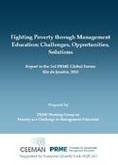
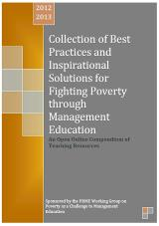
WG Deliverables for 3rd PRME Global Forum and Rio+20 Conference
http://www.ceeman.org/publications/prme-working-group-report-on-fighting-poverty-through-management-education
http://www.ceeman.org/publications/collection-of-best-practices-and-inspirational-solutions-for-fighting-poverty-through-management-education-2nd-edition-in-progress

Slide 16
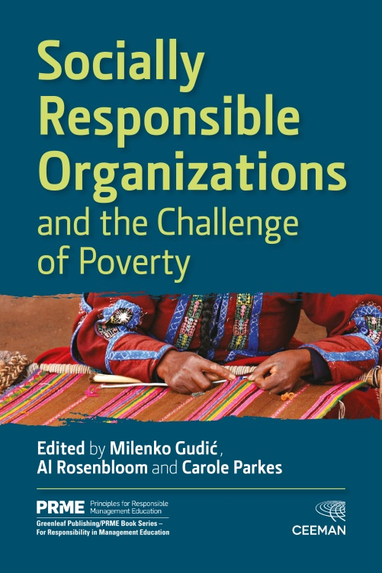
PRME Anti-poverty Working Group: Current and Future Activities
Two Books on WHY and HOW to integrate poverty into management education
Book 1 2014 Managua
Book 2 2015 21st Management Education and the Challenge of Poverty
WG Conference at Bocconi, Milan, Italy at EXPO 2015
Fighting poverty through management education to promote growth, health, employment

Slide 17
Experiential learning conference in Nicaragua INCAE, Managua, 28-30 July 2014
Leveraging Innovative and Cross-country Learning for Poverty Reduction: Climbing the Economic Ladder – Examples from and for Nicaragua
Welcome and opening
Panel I: Nicaragua: context, cases, collaborations
Panel II: Lessons from the rest of the world
Academic paper session 1: Macro level issues – Learning at the country level
Academic paper session 2 : Micro level issues – Learning from entrepreneurs
Academic session 3: Learning from innovations in business schools
Experiential learning study trips – two visits
Debriefing/reflection session
Roundtable discussion
Knowledge integration
Conference conclusion
Poverty book launch

Slide 18
INCAE Business School
INCAE was founded in 1964 as a private, non-profit, multi-national, higher education organization devoted to teaching and research endeavors in the fields of business and economics.
Campuses in Costa Rica and Nicaragua
MBA programs, Exec Ed, Impact Research

Slide 19
INCAE Business School
Mission
“To actively promote the comprehensive development of the countries we serve, enhancing leadership skills within key sectors by improving management practices, attitudes, and values”
Mission Drivers
Researching, teaching, and disseminating management concepts and techniques
Strengthening analytical capabilities
Promoting understanding, dialogue, and cooperation among individuals, sectors, and countries

Slide 20
Key Social Role of INCAE
1970s rebuild of Managua following disastrous earthquake
1980s support for regional agricultural transformation
1980s-1990s support governments in escaping (hyper) inflation
1996 – present Sustainable Development guiding regional research

Slide 21
INCAE-CLACDS
Nearly 100% of INCAE’s institutional research since 1996 has been guided by sustainable development
Intersection of social, environmental, economic and institutional development
Poverty alleviation
Access to energy (energy poverty and renewable focus
Agricultural market access
Microfinance and “green finance”
Entrepreneurship, and business climate for SME development
Most faculty linked in some way to poverty reduction through business development in teaching, consulting and research.

Slide 22
At INCAE’s Francisco de Sola Campus, Managua, Nicaragua

Slide 23
About the conference…
The conference will bring together academicians and practitioners from developed and developed countries in order to pursue the following goals:
Create a space for a multi-stakeholder exchange of ideas, perspectives and best practices.
Use Nicaragua as a learning and innovation laboratory for all participants.
Stimulate the development of a more sustainable and inclusive educational/research mode in management education and responsibility of business towards poverty eradication to the foreground
The program will blend traditional paper presentations with small group break-out sessions and a day-long, field immersion experience on day 2. It will give delegates opportunities for interaction with policy and community leaders as well as with one another.

Slide 24
For more information visit:
http://www.incae.edu/es/clacds/poverty-conference.php
Or write to povertyconference@incae.edu

Slide 25
Appendix I The Anti-poverty Working Group
Working Group Charge from PRME Secretariat
The aim of this collective effort is to work towards a proposal that introduces the issue of poverty in the curriculum and the learning methods in the education of future professionals, as part of the social environment in which business management operates
Vision Statement
The vision of PRME Working Group on Poverty as a Challenge to Management Education is to be advocates for the integration of poverty-related discussions into all levels of management education worldwide

Slide 26
Our vision is grounded in our beliefs that:
Poverty is a legitimate topic for discussion and research in schools of business and management
Business should be a catalyst for innovative, profitable and responsible approaches to poverty reduction
Multiple stakeholder engagement is needed for innovative curriculum development

Slide 27
In our role as advocates, we will:
Create opportunities for multi-stakeholder discussions
Foster discussions that lead to concrete results
Disseminate reports
Serve as a global repository for innovative curricular approaches, learning methods and educational materials that embed poverty in management education
Support the development of a community of management educators, researchers and professionals committed to integrating poverty into the business curriculum
Our working group will disband only when the issue of poverty is deeply embedded in all levels of management education worldwide.

Slide 28
Appendix II PRME Anti-poverty WG membership
120 members
100 institutions
42 countries

Slide 29
Appendix II Some additional materials of interest
UNDP GIM (Growing Inclusive Markets Initiative)
http://growinginclusivemarkets.org/wp3/en/wordpress/wp-content/uploads/2010/04/gim-report_executive-summary_English.pdf
Recent on poverty and wealth distribution:
http://www.utrend.tv/v/9-out-of-10-americans-are-completely-wrong-about-this-mind-blowing-fact/
http://www.npr.org/blogs/thetwo-way/2014/01/20/264241052/oxfam-worlds-richest-1-percent-control-half-of-global-wealth
http://www.oxfam.org/sites/www.oxfam.org/files/bp-working-for-few-political-capture-economic-inequality-200114-summ-en.pdf
The 2013 PRME Summit: Inspirational Institutional/Individual and Working Group‘s Stories
http://ceeman.lecturehub.com/events/172/prme-video-case-stories

